Slide 1
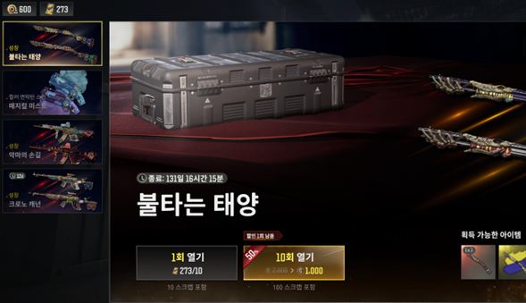


Pubg pc/console 2026 Roadmap: h. 2026 user incentive Strategy & operations
Need for increased rewards and development proposals
Need to boost rewards to be on par with competing titles in terms of traffic
Introduction of event-exclusive gacha
Establish independent event-only gacha currency and gacha pool that do not harm the in-game economy
Provide the sense of achievement of accumulating currency and spinning it all at once, rather than in a random box format
Provide ongoing interest via a hero item refresh about every six months
Time-limited item development (smuggled goods coupons, hunter crates, keys, blueprints, etc.)
ZCoins have too much freedom, making it difficult to constrain actions (therefore important goods are sold for real money)
For smuggled goods coupons, 10 vouchers cost 200 ZCoins, and since popularity is high, distributing items of equal value is also an effective event
Can be useful for running impactful events at key moments
E.g., Taehyun's contraband coupons 100 vouchers (30 days), etc.
Increase of high-value currencies/items
Request to review increases for currencies whose usage expands with system changes like BP and that have higher user preference

Slide 2



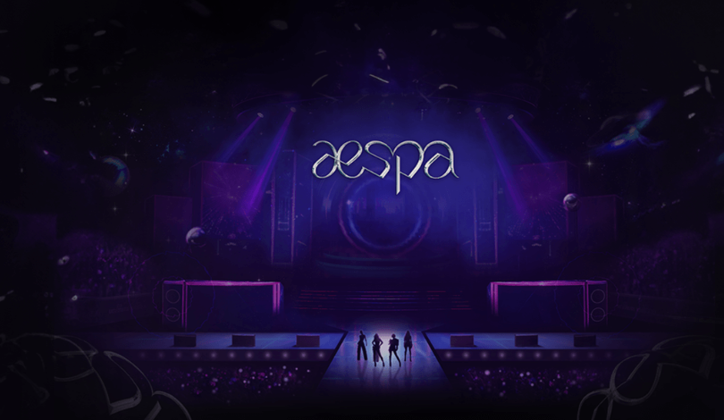



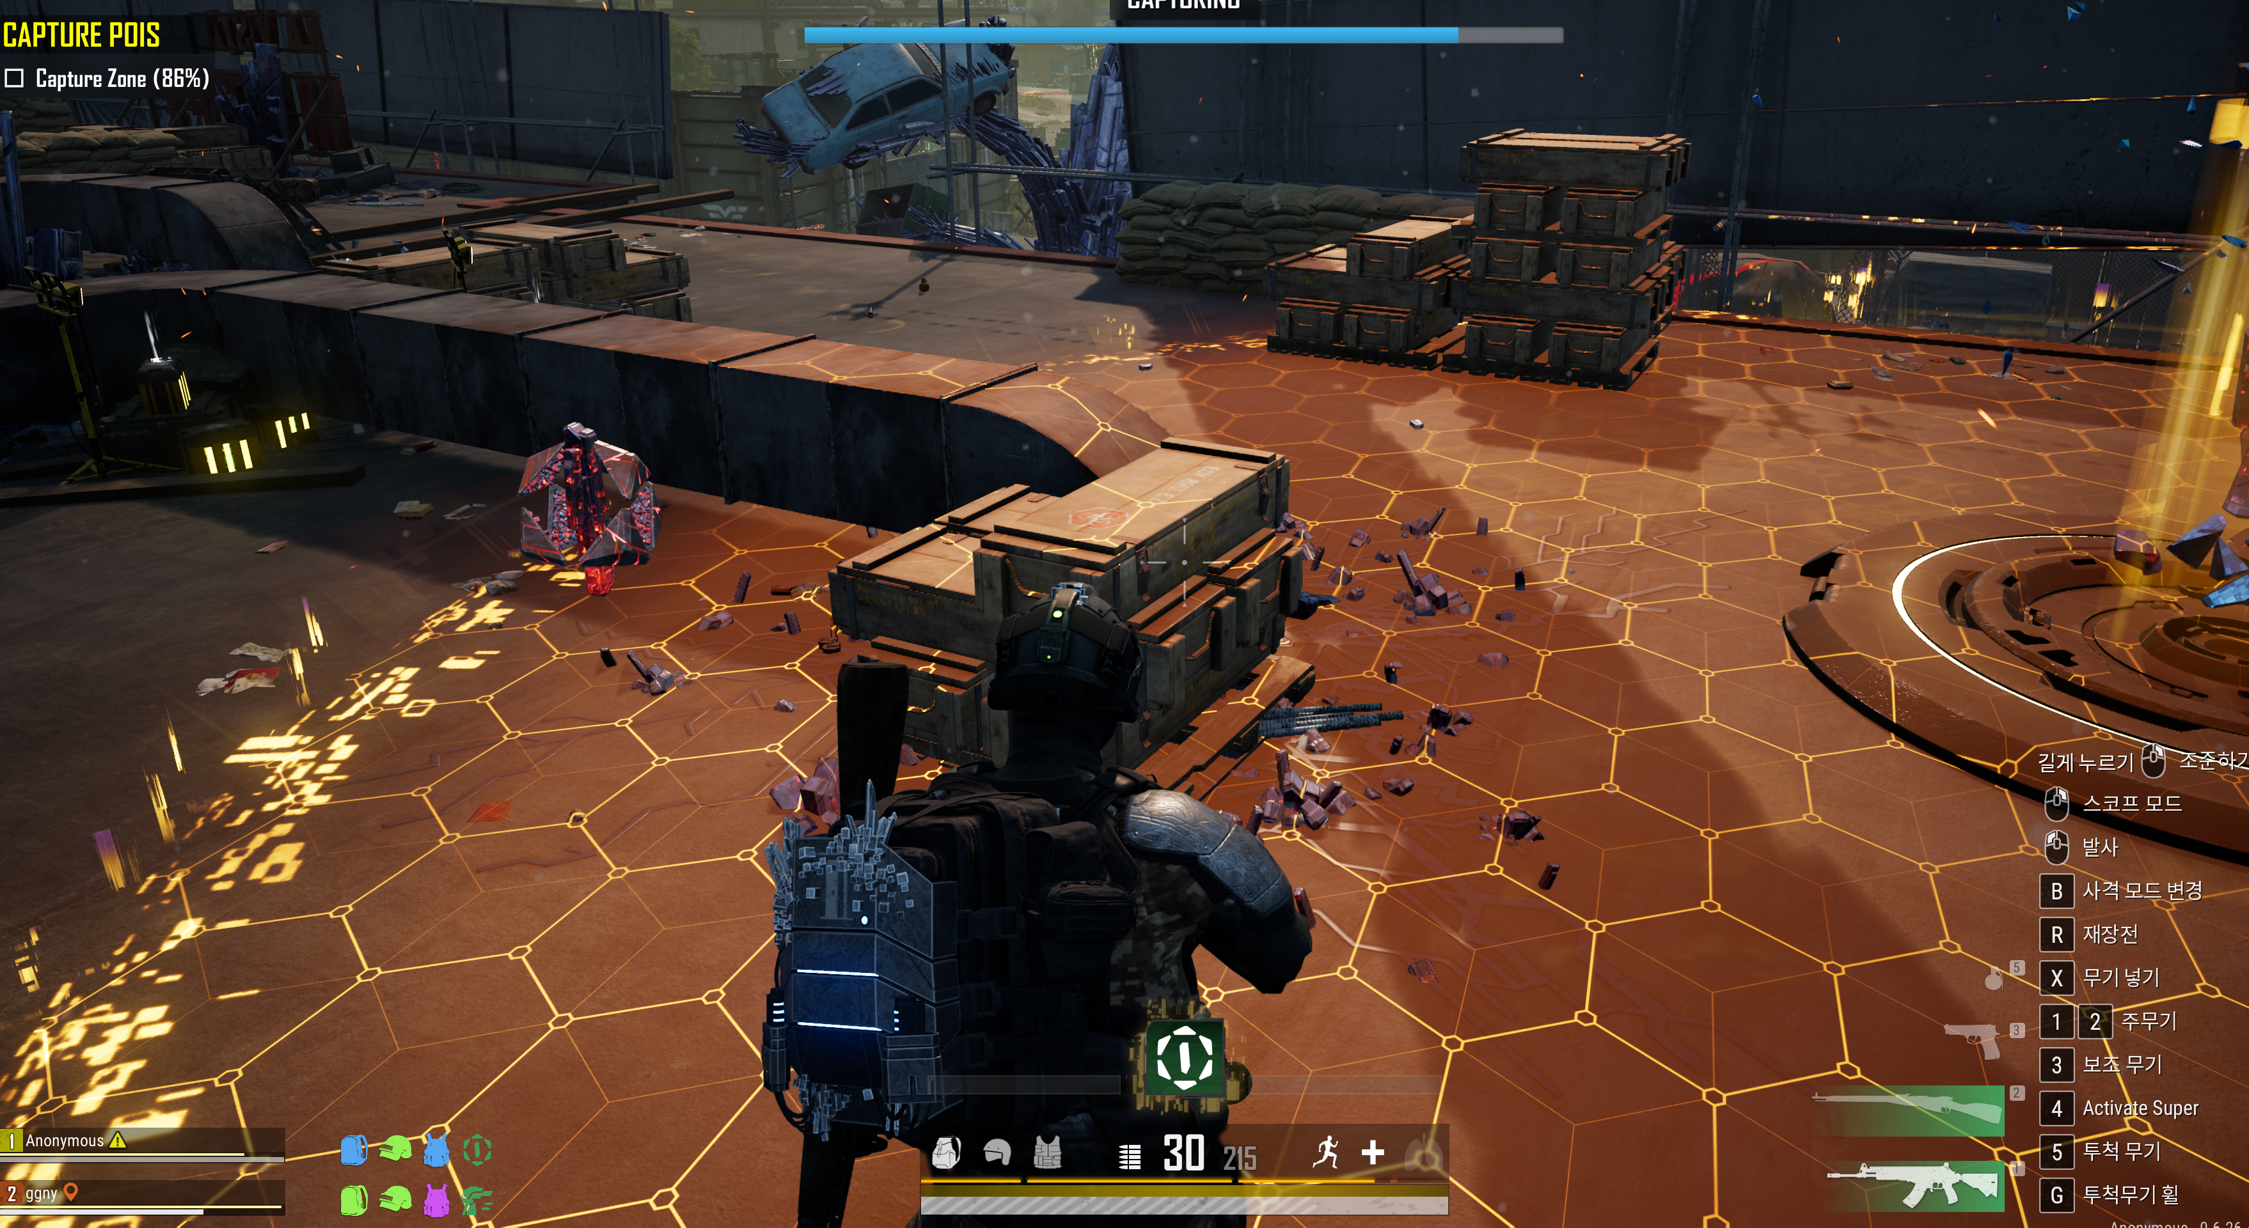


Pubg pc/console 2026 Roadmap: h. 2026 user incentive Strategy & operations
2026 event operation direction
Maximize peak-season traffic and stabilize off-season through reward/content expansion-based event scale-up
Response methods
Key target seasons
2026 event direction
Peak season
1Q (Lunar New Year, N-year anniversary, through April Fools' Day)
Seasonality-based promotion scale-up
Expand event scale based on existing main seasons and core updates
March N-year anniversary, July–August summer vacation, September Chuseok/Mid-Autumn Festival, December large-scale world update
Not only simple rewards and OES expansion but also exposure/participation-oriented actions
E.g., content to prompt streamer events, social challenges, e-sports event teasers and on-site events
Expand scale to attract interest from existing/returning users and new users
Strengthen familiar fun for existing/returning users and provide return incentives
Provide fresh entry points and differentiated experiences for new users
3Q (summer vacation, Chuseok/Mid-Autumn Festival)
4Q year-end (December large-scale world)
Off-season
2Q (Spring season after school starts in April–May)
Deployment of new modes and focused promotion
Deploy newly developed Co-dev modes during off-peak timing to defend traffic and strengthen user engagement
E.g., new modes such as Binary Spot, Heist Royale, etc., showcased as the main feature of the month with focused promotion
Binary Spot
Content strengthening and linked events are needed to maintain a stable off-season
Move away from an anniversary-centric structure; design a defense strategy spanning from March to the second quarter (the same after September Chuseok)
Actively implement promotions with rewards usable for traffic defense in conjunction with new modes and other content
4Q (October–November between Chuseok and year-end)
Heist Royale (Payday)

